Slide 1
Collaboration with Github
1 issues
2 branching
3 commits
4 review
5 merge strategies
6 resolving conflicts
7 branch management
Software Engineering Project
Collaboration with GitHub
slide 1

Slide 2
A full example
1 issues
2 branching
3 commits
4 review
5 merge strategies
6 resolving conflicts
7 branch management
Your team finds a bug and agree it needs to be fixed.
Create an issue (relating to the bug)
Create a branch (relating to that issue)
Write, test and commit code fixing the bug
Code is reviewed (via a pull request)
Code is merged (bug is fixed, issue is closed)
Software Engineering Project
Collaboration with GitHub
slide 2

Slide 3
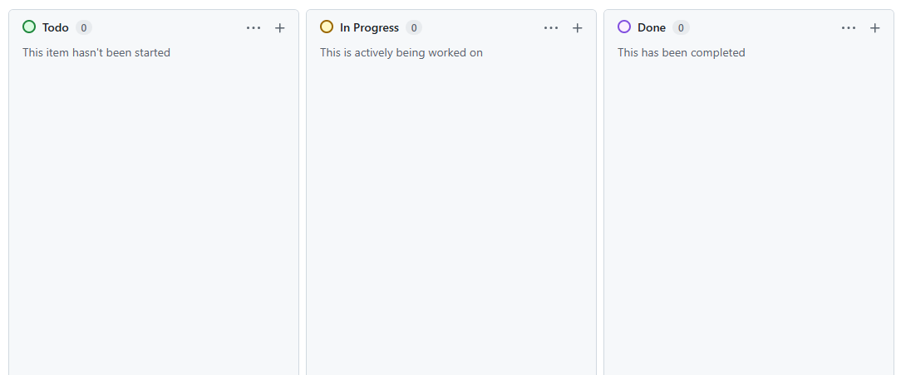
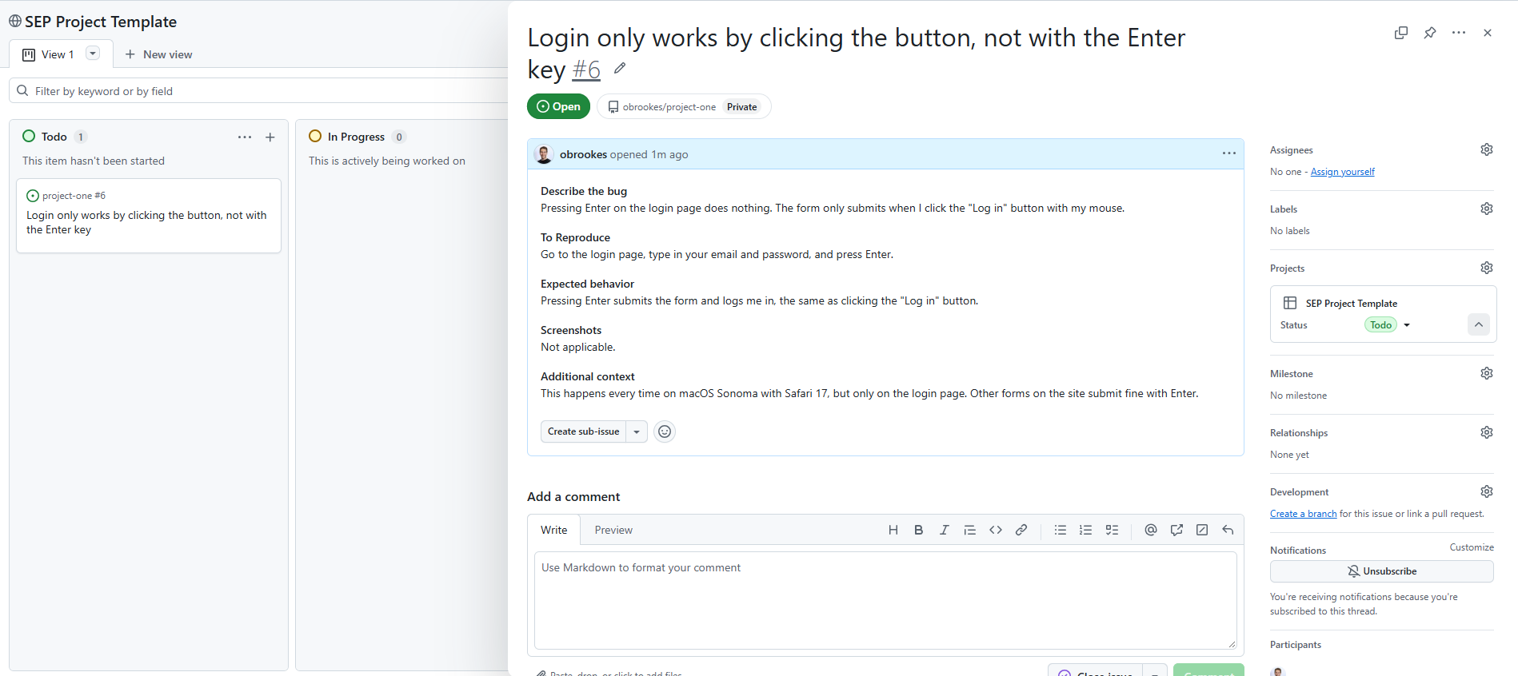
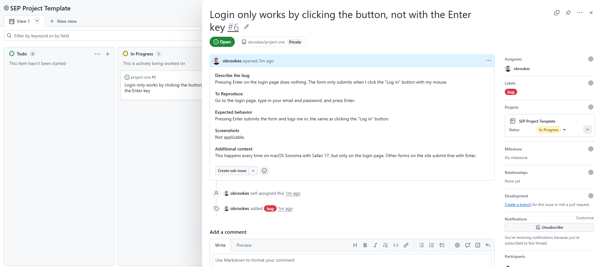
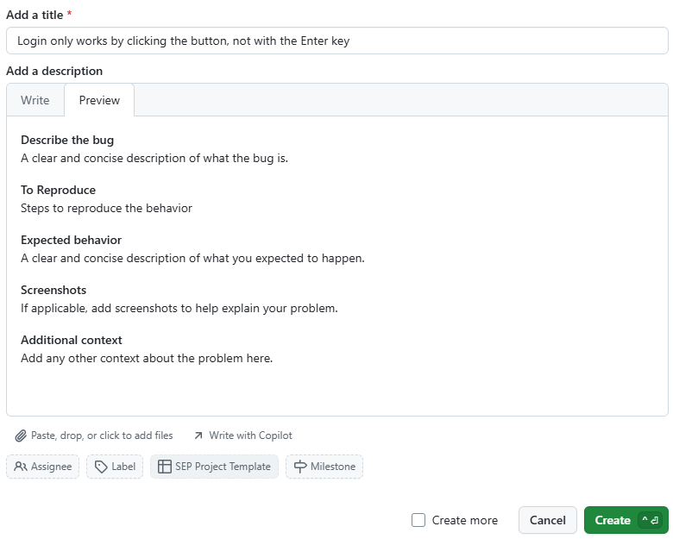
Create an issue (relating to the bug)
1 issues
2 branching
3 commits
4 review
5 merge strategies
6 resolving conflicts
7 branch management
Title
New issue
Issue #6
Assignee
Label
Todo
In Progress
Template
Status
1
Blank board
2
New issue
3
Card in Todo
4
Assign, label, status
Software Engineering Project
Collaboration with GitHub
slide 3

Slide 4
Branching
1 issues
2 branching
3 commits
4 review
5 merge strategies
6 resolving conflicts
7 branch management
It is a good idea to name your branches after issues. It is generally good practice to have one branch for one issue.
Try to give the branch name a type (e.g., bug, fix, doc), issue number and a short description to make each branch traceable. A good name says what the work is and which issue it belongs to:
<type>/<issue-number>/<short-description>
git switch -c bug/6/add-enter-login # Create and switch branch
There are many conventions. Pick one convention per team and stick to it – consistency and agreement within the team is important
bug/6/add-enter-login # type prefix
obrookes/6/add-enter-login # owner prefix
6-add-enter-login # number first
Software Engineering Project
Collaboration with GitHub
slide 4

Slide 5
Reading your branches: git branch -a
1 issues
2 branching
3 commits
4 review
5 merge strategies
6 resolving conflicts
7 branch management
A tidy branch list shows all the work that is currently ongoing concisely
git branch -a
git branch -a
* bug/6/add-enter-login
bug/4/handle-empty-export
docs/5/add-reset-guide
feat/1/add-login-page
dev
main
remotes/origin/bug/6/add-enter-login
remotes/origin/dev
...
AH-Branch-2
final2
* test
my-branch
fix
docs-update
dev
main
remotes/origin/test
Consistent names let you spot yours and your team-mates’ work easily
Type and issue number show what each branch is for, and when it can be deleted
Vague names like test or fix hide who owns a branch and whether it is still needed
Software Engineering Project
Collaboration with GitHub
slide 5

Slide 6
Writing good commits
1 issues
2 branching
3 commits
4 review
5 merge strategies
6 resolving conflicts
7 branch management
Check you are on your issue branch before you commit
git status # check you are on bug/6/add-enter-login
Keep commits atomic: one logical change each, so they are easy to review and revert
git commit -m "test: add failing test for Enter key (#6)"
git commit -m "fix: wrap login inputs in <form> (#6)"
Write a concise subject (about 50 characters, imperative), add a body for the why, and put the issue number. This is because commits persist even after a branch is deleted.
git commit -m "fix: wrap login inputs in <form> (#6)"
-m "Enter only submits a form"
Software Engineering Project
Collaboration with GitHub
slide 6

Slide 7
Commit history: git log
1 issues
2 branching
3 commits
4 review
5 merge strategies
6 resolving conflicts
7 branch management
Commit history should be easy to understand at a later date
git log --oneline
git log --oneline
b3e8f12 fix: wrap inputs (#6)
5a0c7d9 test: add Enter test (#6)
c52b9a4 fix: empty export (#4)
8d41e07 docs: reset guide (#5)
3f9a1c2 feat: add login page (#1)
a91f3c0 wip
7d2e8b1 final2
c40b6a9 fixed-stuff
e1f93d7 asdf
2b8c0f4 Update
A good history reads like a changelog: what changed, and which issue
A prefix such as fix: or test: and the issue number make commits easy to search
Messages like wip or final2 say nothing, so nobody can find, review or safely revert a change
Once you are done with the fix, push to publish the branch:
git push -u origin bug/6/add-enter-login # publish the branch
Software Engineering Project
Collaboration with GitHub
slide 7

Slide 8
Preparing a pull request
1 issues
2 branching
3 commits
4 review
5 merge strategies
6 resolving conflicts
7 branch management
When you are ready to integrate your changes, you will need to open a pull request (PR) – they are tools to enable code to be reviewed by team-mates before it is merged
While reviews will be performed by your team-mates, it is your responsibility to make the code reviewable
Keep it small: one PR per issue. Small PRs are reviewed faster and hide fewer bugs, ideally between 50-200 lines of code
Sync with dev and fix conflicts first: a PR with conflicts cannot be merged
git merge dev # back-merge – more on this later
Review your own diff first - look for debug prints, typos and stray files
git diff dev
Title it clearly and say what, why, how. You should also include testing details.
Fixes #6 # closes the issue on merge
Software Engineering Project
Collaboration with GitHub
slide 8

Slide 9
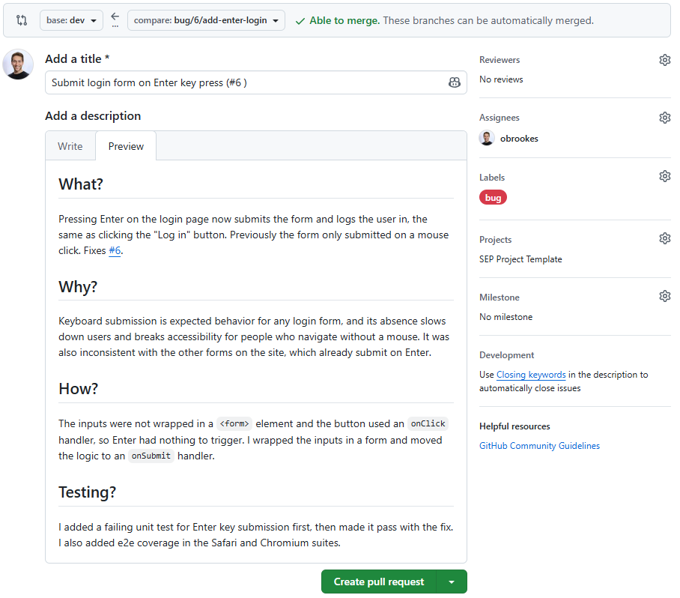
An example pull request
1 issues
2 branching
3 commits
4 review
5 merge strategies
6 resolving conflicts
7 branch management
Branches
Merging your branch into dev
Reviewers
Title
Assignee
Short summary with the issue number
Labels
Fixes #6
Closes the issue when merged
Description
What, why, how and how it was tested
Opens the pull request for review
Create
Software Engineering Project
Collaboration with GitHub
slide 9

Slide 10
Reviewing a pull request
1 issues
2 branching
3 commits
4 review
5 merge strategies
6 resolving conflicts
7 branch management
Why perform code reviews? It improves code quality, catches bugs and improves knowledge of the codebase throughout the whole team.
Sanity check: is the PR linked to an issue, with test steps?
Run the code: check out the branch and follow the PR’s test steps. Try to break it
Scan the file list for files that do not belong
git fetch
git switch bug/6/add-enter-login
✓ login.py
✓ test_login.py
✗ .env # secrets
✗ dist/app.min.js # build file
Read the code: logic, clarity, error handling, and tests for new code. Unclear code should be simplified.
Software Engineering Project
Collaboration with GitHub
slide 10

Slide 11
Giving feedback on a pull request
1 issues
2 branching
3 commits
4 review
5 merge strategies
6 resolving conflicts
7 branch management
Review the code, not the person: feedback is a conversation
Phrase comments as suggestions, not commands
Comment kindly: write suggestions, not commands, and avoid “you”
✗ You forgot to add any
unit tests
Prefix minor points with Nit: and praise good code too
✓ This new function could
benefit from a unit test
for the edge cases
Assume good intent and explain any disagreement in the thread
✓ Nit: rename fData to formData
Approve or request changes; two reviewers must approve every PR
✓ Nice use of early returns!
Nit is short for nitpick: a minor point the author may skip
Software Engineering Project
Collaboration with GitHub
slide 11

Slide 12
Code review: general advice
1 issues
2 branching
3 commits
4 review
5 merge strategies
6 resolving conflicts
7 branch management
Code review is normal, and help is always available
Expect feedback
Expect multiple reviews
No changes means the review was not done properly
Feedback is a gift, try not be defensive
If you are stuck
If you do not understand the code, it is probably not you
Ask to pair-review
Still unsure? Ask the TAs or come to the drop-ins
Plan your reviews
Is the PR too big? Reject it and ask for smaller PRs
Agree in advance who reviews when, and make it realistic
Do not aim to merge on deadline day
Software Engineering Project
Collaboration with GitHub
slide 12

Slide 13
1 issues
2 branching
3 commits
4 review
5 merge strategies
6 resolving conflicts
7 branch management
Merging: Plain Merge
You will need to merge a lot, doing it often will make it much less painful.
feature
branch
dev
A plain merge represents the simplest scenario. It just moves dev forward, so the feature’s commits join present linearly
b5d2e71
3f9a1c2
Branch off dev and commit on the feature branch (pink); dev has not moved
71ae3d5
71ae3d5
71ae3d5
With nothing new on dev, Git needs no merge commit: it just moves dev forward onto the feature’s commits
e90f6b1
same hashes
e90f6b1
e90f6b1
4c8a2d6
git switch dev
git merge bug/6/add-enter-login
# Fast-forward
4c8a2d6
4c8a2d6
The result is one straight line. The commits keep their same hashes, but nothing records that they were a branch
Software Engineering Project
Collaboration with GitHub
slide 13

Slide 14
1 issues
2 branching
3 commits
4 review
5 merge strategies
6 resolving conflicts
7 branch management
Merging: No fast-foward
Forcing a merge commit keeps the feature visible in history, so it can be found and reverted as one unit.
feature
branch
dev
Branch off dev and commit on the feature branch; dev has not moved
b5d2e71
A fast-forward would be possible, but --no-ff makes Git create a merge commit anyway
3f9a1c2
git switch dev
git merge --no-ff bug/6/add-enter-login
71ae3d5
The merge commit has two parents, so history still shows the branch and its commits grouped together
e90f6b1
4c8a2d6
git log --oneline --graph -5
* d19c4e8 Merge bug/6/add-enter-login
|\
| * 4c8a2d6
| * e90f6b1
| * 71ae3d5
|/
* 3f9a1c2
d19c4e8
merge commit
Software Engineering Project
Collaboration with GitHub
slide 14

Slide 15
1 issues
2 branching
3 commits
4 review
5 merge strategies
6 resolving conflicts
7 branch management
Merging: Back-merge and fast-forward
Back-merging first means conflicts are fixed on your branch, and dev then catches up cleanly.
feature
branch
dev
Branch off dev and commit on your feature branch. Meanwhile, other work lands on dev and your branch falls behind
b5d2e71
3f9a1c2
Back-merge: merge dev into your branch to pick up that work. Dev is untouched
71ae3d5
c52b9a4
git switch bug/6/add-enter-login
git merge dev
e90f6b1
8d41e07
Now dev lacks nothing your branch has, so --ff-only just moves it forward, with no merge commit
f27a6d0
f27a6d0
same commit
git switch dev
git merge --ff-only bug/6/add-enter-login
Software Engineering Project
Collaboration with GitHub
slide 15

Slide 16
1 issues
2 branching
3 commits
4 review
5 merge strategies
6 resolving conflicts
7 branch management
Merging: Rebase
Rebase replays your commits on top of dev, so history stays linear
feature
branch
dev
Branch off dev and commit; meanwhile other work lands on dev
b5d2e71
Rebase copies your commits onto dev’s latest. The copies sit on the feature branch
3f9a1c2
git switch bug/6/add-enter-login
git rebase dev
71ae3d5
71ae3d5
abandoned
c52b9a4
Each copy gets a new hash (5a0c7d9 was 71ae3d5); the originals are abandoned
e90f6b1
e90f6b1
bug/6
8d41e07
bug/6
Then fast-forward dev: one straight line, no merge commit
5a0c7d9
was 71ae3d5
5a0c7d9
git switch dev
git merge --ff-only bug/6/add-enter-login
b3e8f12
was e90f6b1
b3e8f12
bug/6
dev
Never rebase a shared branch: teammates still have the old commits, so their history clashes with yours and work gets duplicated
Software Engineering Project
Collaboration with GitHub
slide 16

Slide 17
Merge conflicts
1 issues
2 branching
3 commits
4 review
5 merge strategies
6 resolving conflicts
7 branch management
Both branches changed the same lines – git does not know which is correct
dev · login.py
bug/6/add-enter-login · login.py
def login(form):
if not form.is_valid():
return error("Wrong password")
return redirect("/home")
def login(form):
if not form.is_valid():
return error("Invalid login")
return redirect("/home")
A teammate changes line 3 on dev and merges it
You change the same line on your branch, started from the same commit
There is now a conflict which must be resolved manually
Software Engineering Project
Collaboration with GitHub
slide 17

Slide 18
Merge conflicts
1 issues
2 branching
3 commits
4 review
5 merge strategies
6 resolving conflicts
7 branch management
git switch bug/6/add-enter-login # switch to your branch
git merge dev # back-merge: bring dev in
Auto-merging login.py
CONFLICT (content): Merge conflict in login.py
Automatic merge failed; fix conflicts and then commit the result.
login.py · merge in progress
Git pauses the merge and writes both versions into login.py
def login(form):
if not form.is_valid():
<<<<<<< HEAD
return error("Invalid login")
=======
return error("Wrong password")
>>>>>>> dev
return redirect("/home")
HEAD is the latest commit on your current branch, so it labels your side of the conflict
current change (yours)
The changes on your current branch (bug/6/add-enter-login) sit above =======, the incoming (dev) ones below
incoming change (dev)
Software Engineering Project
Collaboration with GitHub
slide 18

Slide 19
Resolving merge conflicts
1 issues
2 branching
3 commits
4 review
5 merge strategies
6 resolving conflicts
7 branch management
Edit the file: keep one side, or combine both, then delete the markers
HEAD
return error("Invalid login")
resolved
return error("Login failed")
incoming
return error("Wrong password")
Stage the file and commit to finish the merge
git add login.py # mark as resolved
git commit # complete the merge
You can always start again:
git merge --abort # undo the merge attempt
Software Engineering Project
Collaboration with GitHub
slide 19

Slide 20






Pull Request Workflow
1 issues
2 branching
3 commits
4 review
5 merge strategies
6 resolving conflicts
7 branch management
Author / Developer
Reviewers
Open an Issue
Create a Branch for the Issue
Fix the Issue and Commit
Open a Pull Request (PR)
Assign Reviewers
Merge Pull Request
Reviewers Review Code and Suggest Improvements
Yes
Reviewers Approve of Code?
No
Reviewers Add Comments to Explain Changes
Commit Fixes to Code
Software Engineering Project
Collaboration with GitHub
slide 20

Slide 21
1 issues
2 branching
3 commits
4 review
5 merge strategies
6 resolving conflicts
7 branch management
Branch Management - Git Flow
The GitFlow workflow is a very successful branch management strategy
dev
main
Only two branches are persistent: main and dev
Initial production
version
main is the production branch: its code is always ready to ship, and every commit on it is (by definition) a release
dev collects the team’s latest finished work; you can think of it as the integration branch. Automated nightly builds are based on dev
When dev is stable, merge it into main and tag a version number: that merge is the release
Next production
release
git switch main
git merge --no-ff dev
git tag -a 1.2
Next production
release
Because every main commit is a release, a hook can deploy it automatically
Work in progress on
"next release"
Software Engineering Project
Collaboration with GitHub
slide 21

Slide 22
1 issues
2 branching
3 commits
4 review
5 merge strategies
6 resolving conflicts
7 branch management
Feature Branches
Feature branches are a key component and allow work to be isolated from dev.
feature
branches
dev
Branch off dev for each feature or fix. Any name works except main, dev, release-* or hotfix-*
git switch dev
git switch -c bug/6/add-enter-login
New feature branch
starts from dev
Commit freely on your branch: dev carries on without your unfinished work
git commit -m "fix: wrap inputs (#6)"
When complete, merge back into dev, then delete the branch so branches never pile up
Merged back into dev
when complete
git switch dev
git merge --no-ff bug/6/add-enter-login
git branch -d bug/6/add-enter-login
The lifespan of feature branches is days
Software Engineering Project
Collaboration with GitHub
slide 22

Slide 23
1 issues
2 branching
3 commits
4 review
5 merge strategies
6 resolving conflicts
7 branch management
Release Branches
A release branch freezes the release, so new features can continue on dev while it is stabilised.
dev
release
branches
main
Branch off dev once it holds everything planned for the release, and assign the version number
Tag
1.1
git switch -c release-1.2 dev
Only bug fixes go on the release branch, while new features continue on dev
Branch off when dev reflects the release
To ship, merge into main and tag it: this is the new production release
Version 1.2
assigned here
git switch main
git merge --no-ff release-1.2
git tag -a 1.2
Bug fixes only
Then merge into dev so the fixes are not lost, and delete the branch
Tag
1.2
git switch dev
git merge --no-ff release-1.2
git branch -d release-1.2
✕ release-1.2 deleted
Software Engineering Project
Collaboration with GitHub
slide 23

Slide 24
1 issues
2 branching
3 commits
4 review
5 merge strategies
6 resolving conflicts
7 branch management
Hotfix Branches
A hotfix branch fixes production immediately, without shipping unfinished work or stopping the team.
dev
hotfixes
main
A severe bug is live: branch from main, so no unfinished work comes along
Tag
1.2
git switch -c hotfix-1.2.1 main
Bump the version and commit the fix, while the team keeps working on dev
git commit -am "Bump version to 1.2.1"
Merge into main and tag it, so production gets the fix straight away
git switch main
git merge --no-ff hotfix-1.2.1
git tag -a 1.2.1
Tag
1.2.1
Severe bug fixed for production: hotfix 1.2.1
Merge into dev too so the next release keeps the fix, then delete the branch
git switch dev
git merge --no-ff hotfix-1.2.1
git branch -d hotfix-1.2.1
Software Engineering Project
Collaboration with GitHub
slide 24

Slide 25
Git Flow Overview
1 issues
2 branching
3 commits
4 review
5 merge strategies
6 resolving conflicts
7 branch management
Git Flow looks complicated, but each step is one small move: a branch, a few commits, a merge.
v1.0
v1.1
v1.1.1
main
hotfix
release
dev
feature
Time
1
main = live, dev = next release
2
Feature: branch off dev, merge back
3
Release: branch off dev, merge into main and dev
4
Hotfix: branch off main, merge into main and dev
Software Engineering Project
Collaboration with GitHub
slide 25

Slide 26
Recap: bug #6 from issue to merge
1 issues
2 branching
3 commits
4 review
5 merge strategies
6 resolving conflicts
7 branch management
1
Issue
#6 Login only works by clicking the button
2
Branch
git switch -c bug/6/add-enter-login
3
Commit
git commit -m "fix: wrap login inputs in <form> (#6)"
4
Push
git push -u origin bug/6/add-enter-login
5
Pull request
Fixes #6 # in the PR description, into dev
6
Review and merge
Two approvals, then Merge pull request
Software Engineering Project
Collaboration with GitHub
slide 26

